Slide 1
Final Presentation
Landing Concept
Martin Brodbeck
Philipp Woditsch

Slide 2
Agenda
Target: Autonomous Landing
Infrared Sensor
Ultrasonic Sensor
Laser Sensor
Wiring and Implementation
Landing Concepts
Open Points
Hochschule Esslingen

Slide 3
Target: Autonomous Landing
Main Goal
Get the HElikopter to land by itself.
Planned Milestones
Test Infrared-Sensor
Getting good values from IR
Develop Landing-Control
Hochschule Esslingen

Slide 4
Target: Autonomous Landing
Actual Milestones
Test IR-Sensor
Validate big differences in IR measurments
Discuss new sensor (concept)
Search for Ultrasonic sensors
Order Laser sensor
Test Laser sensor
Develop function for Laser sensor
Hochschule Esslingen

Slide 5
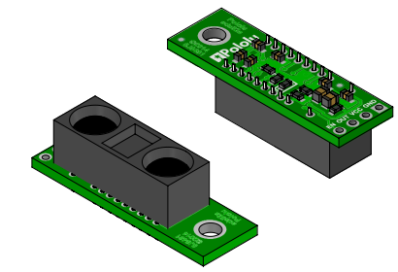
Infrared Sensor
Problem:
Provides only analog values
Solution:
Analog-Digital-Converter via I²C
The IR-Sensor is not configureable. We can only adjust the ADC.
ADS1015 on
Pololu Carrier
Hochschule Esslingen

Slide 6
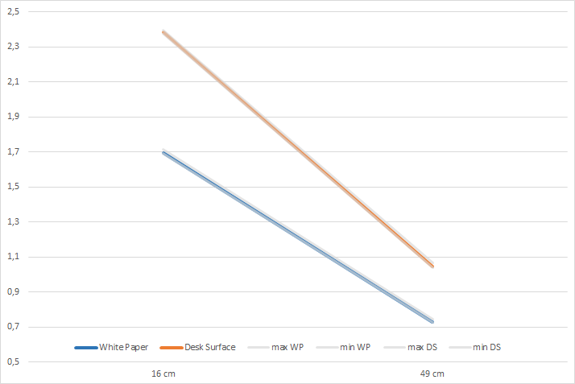

Infrared Sensor
Hochschule Esslingen

Slide 7
Infrared Sensor
After several measurements we realized the high difference in the output values, depending on the surface.
Because of that, we decided not to use the IR-Sensor.
Hochschule Esslingen

Slide 8
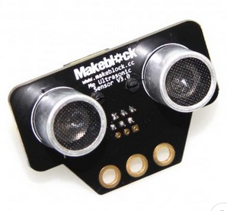
Ultrasonic Sensor
Problem:
Indoor multiple echos from desk, etc.
Possible Solution:
Use 3 fusioned sensors, to „verify“ the values.
→ Not used.
Hochschule Esslingen

Slide 9
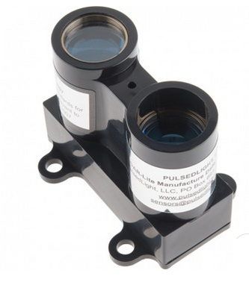
Laser Sensor
Specification:
  Range: 0 - 40m
  Weight: 22g
  Resolution: 1cm
Interfaces:
  PWM
  I²C-Bus (Standard Mode, 100 kbit/s)
Problem:
  Due to the load, the first I²C-Bus on the board needs to run with 400 kbit/s.
Hochschule Esslingen

Slide 10
Laser Sensor
Solution:
Activate 2nd I²C-Bus on the Board.
By default Flexible Flat Cable (FFC) is needed to plug in the second (I2C-0) Bus. Redirection to GPIOs was possible. This is much easier and a better connection is good during flying.
Class 1 Laser Product:
Save on under all conditions. No danger to health. Even when used with optics (telescope, etc.).
Hochschule Esslingen

Slide 11
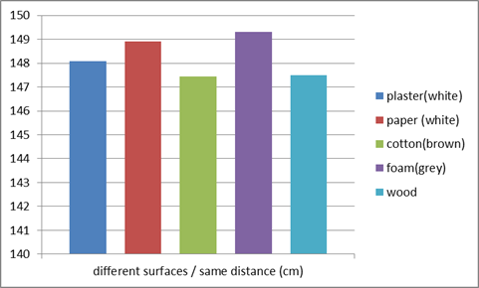
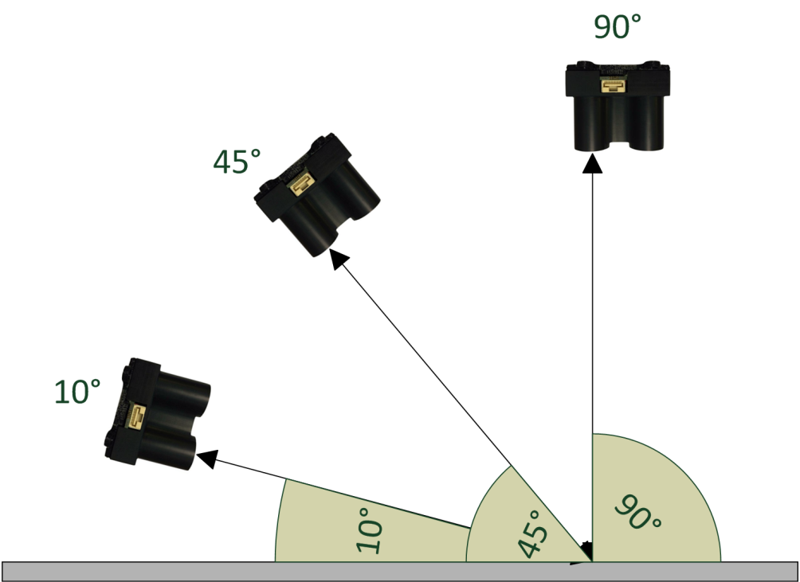
Laser Sensor
Tested and verified accuracy of +/- 2cm
Independet of most surfaces
Tested angle up to 10° to ground
Hochschule Esslingen

Slide 12
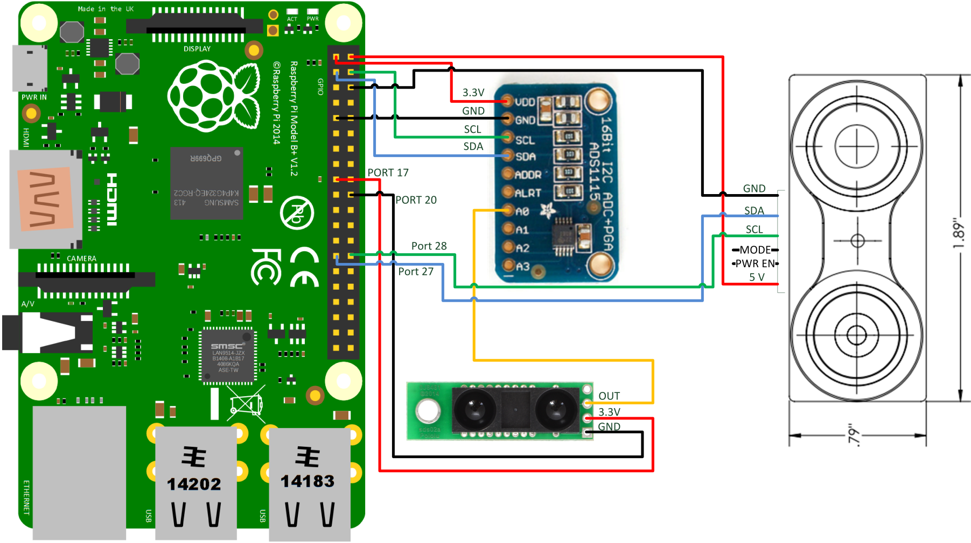
Wiring and Implementation
Using GPIOs & I²C for communication
Implementation of driver and access routines in C
Laser
Hochschule Esslingen

Slide 13
Wiring and Implementation
GPIO Pin Header for all devices
Using python script while boot for reconfiguration of I²C
Low Level Driver for I²C
  ADC -> I²C-1
  Laser Sensor I²C-0
Access Routines (HAL) for ADC and Laser Sensor
  Trigger Measurement and read values
Infrared Access via ADC (read only)
Testing and Validation with C Routines
Hochschule Esslingen

Slide 14
Landing Concepts - Theories
Challenges in autonomous landing:
Drift
Orientation
Distance to ground
Free Landing Zone
Hochschule Esslingen

Slide 15
Landing Concepts - Theories
Drift countermeasures:
GPS Modul? ← not possible indoor
React on
  IMU changes
  Gyro changes
Distance to ground:
Reliable values needed
Stables values, to prevent „jumping“
  Average over several values
→ Laser Sensor provides very good values
Hochschule Esslingen

Slide 16
Landing Concepts - Theories
Landing Zone:
To ensure there is no obstacle, where we want to land we thought about 3 different ways:
Circling
Remembering (Map)
Lateral buckling
  Very low degrees neeed, depending on height
Hochschule Esslingen

Slide 17
Open Points
No actuators which react on sensors
No external signals processed
No controllers which work in between
Hochschule Esslingen

Slide 18
Thank you for
your attention ☺
Hochschule Esslingen

